Slide 1
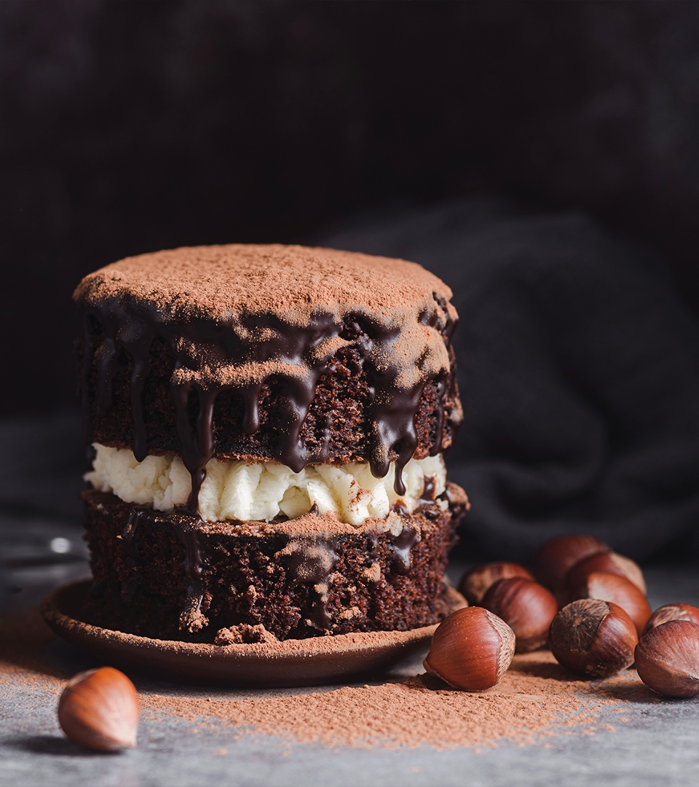
CRAVIGNS
Your Cooking PAL !

Slide 2

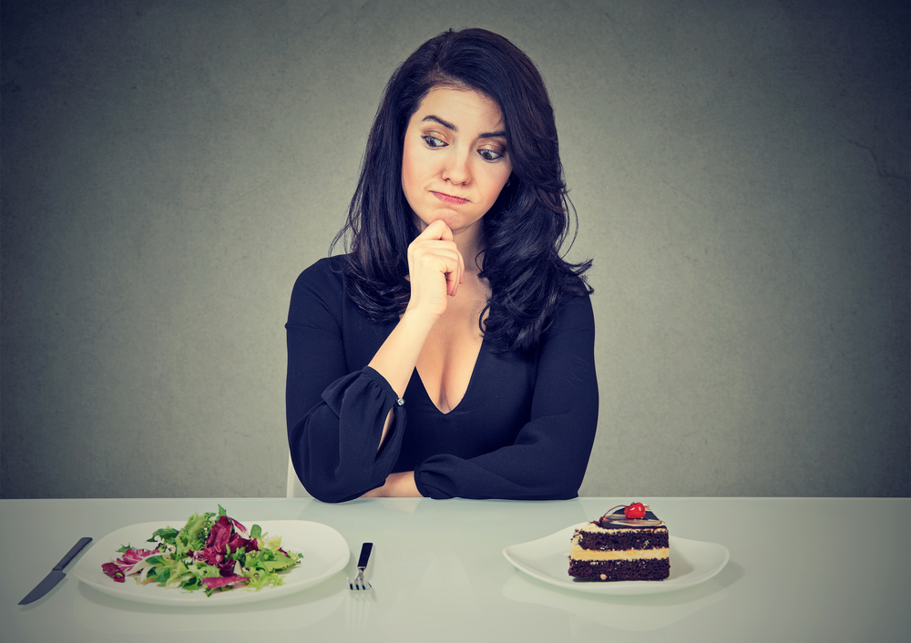
What do I want to eat ?

Slide 3
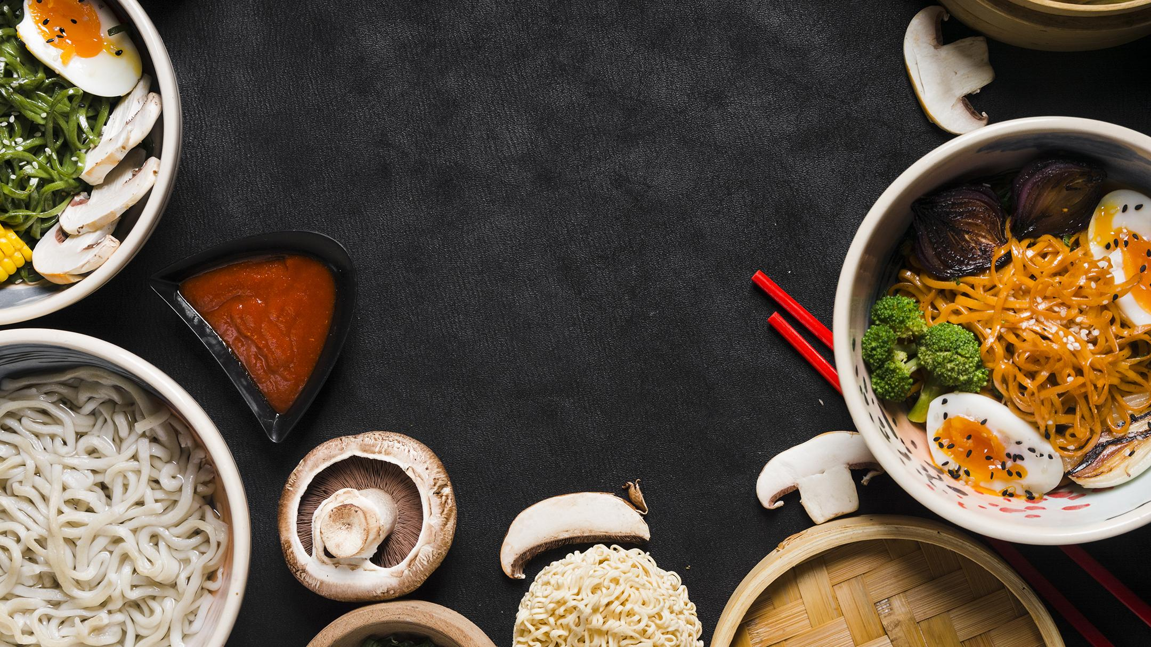
STARTERS
Team introduction
FIRST COURSE
Introduction of the product
MAIN COURSE
Product Demo
DESSERTS
Future improvements

Slide 4
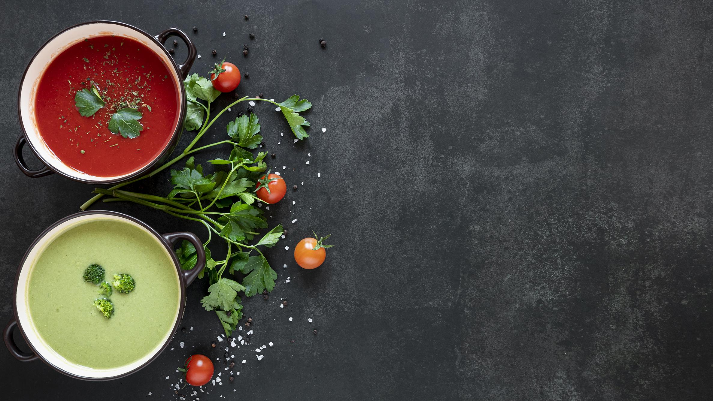

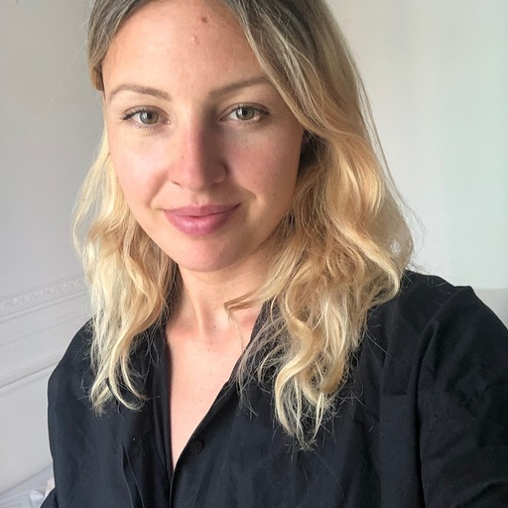

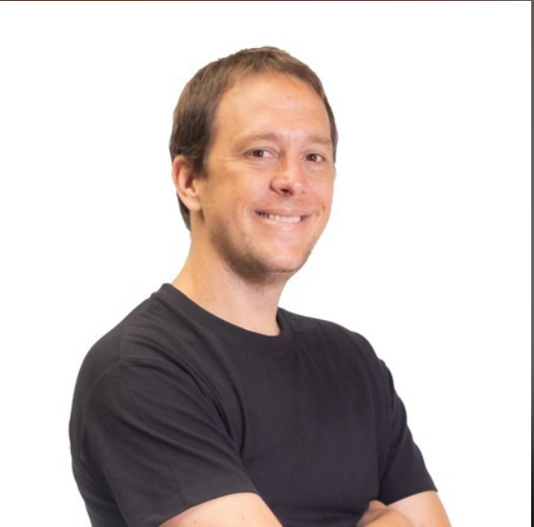
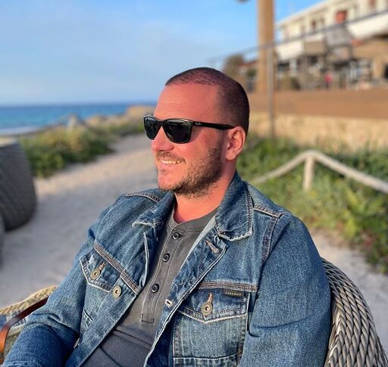
The Chefs
Amelie Haberland
Fabio Blank da Costa
Federico Cavanagh
Javier De Las Heras

Slide 5
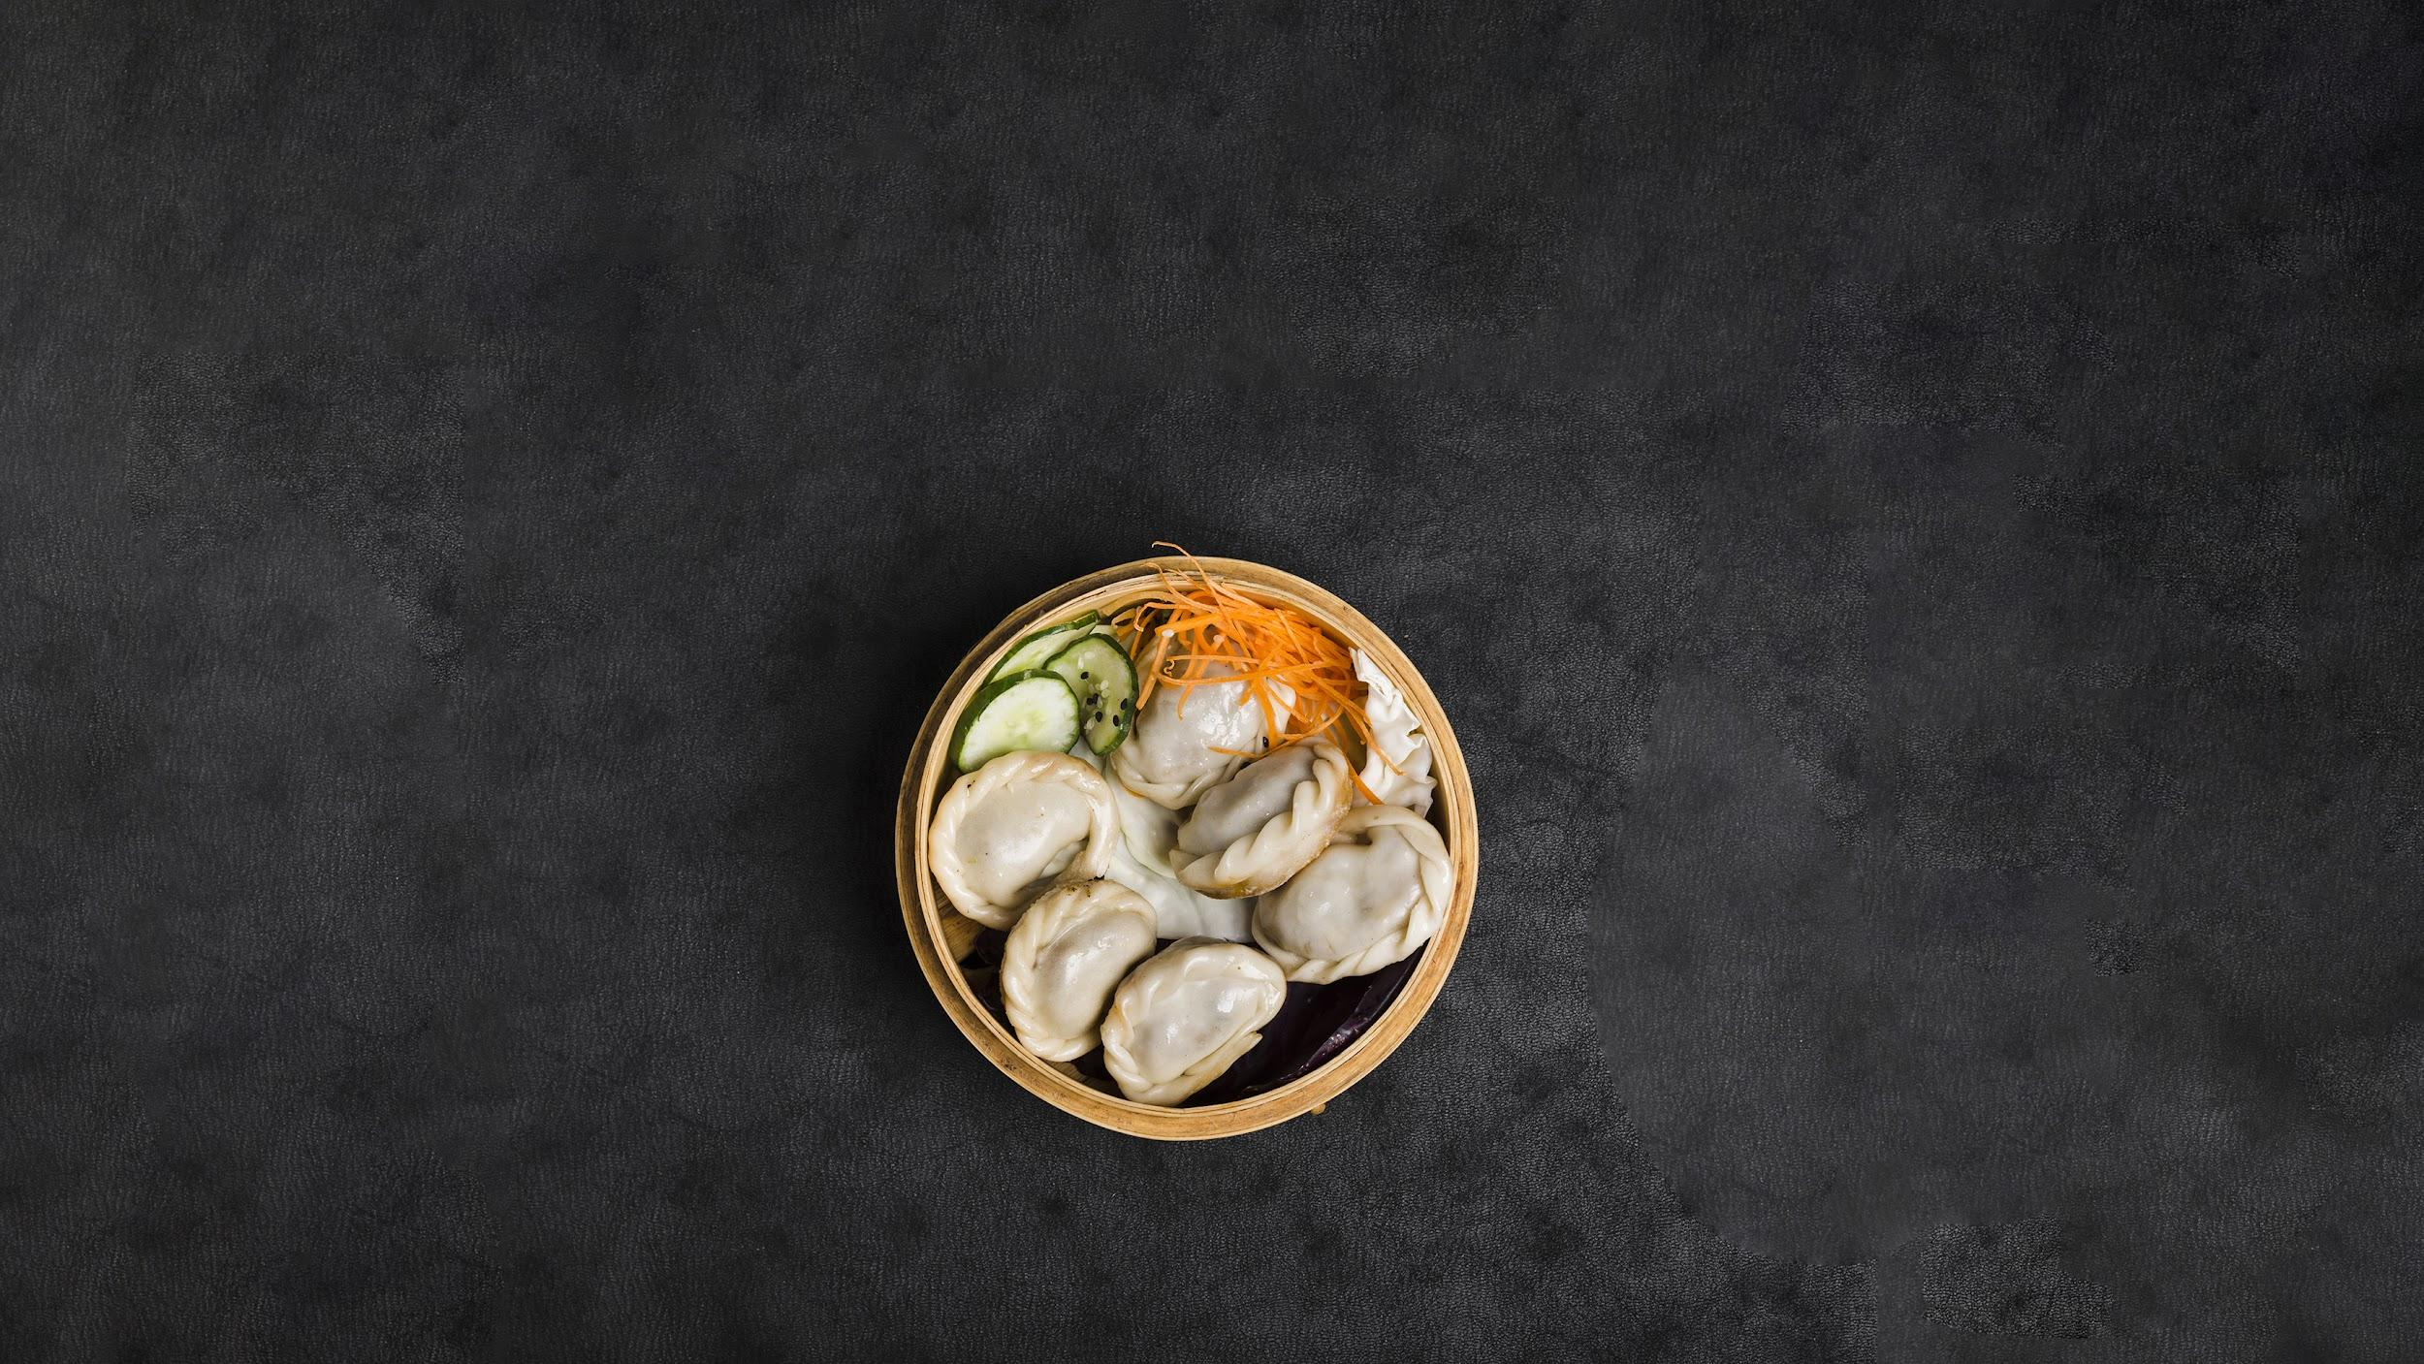
Features
Easy and quick to use, no tech knowledge necessary
Shows cooking time for each recipe
Provides list of missing items with prices
Quick recipes with nutritonal information
PDF with shopping list and recipe

Slide 6
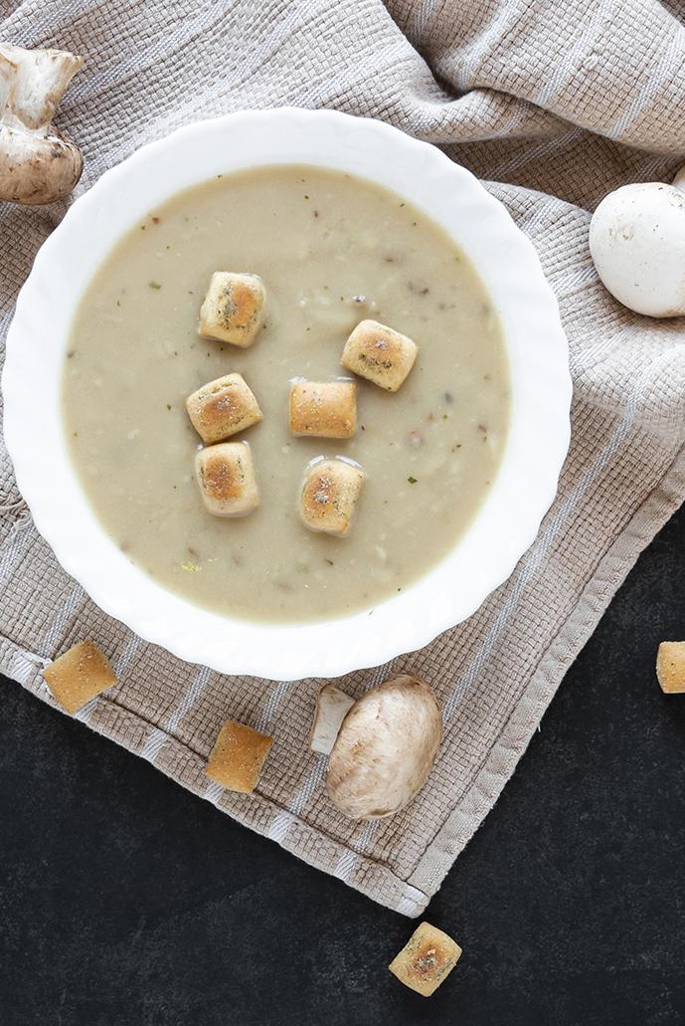
Resources
01.
02.
03.
04.
Edamam - API
Abelandcole – Web Scraping
Spacy – Natural Language Processing
FDPF – Library to generate PDF documents

Slide 7

Time for the demo

Slide 8
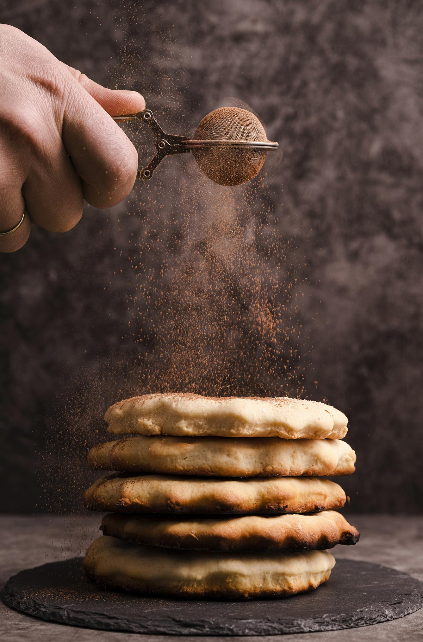
Future Improvements:
Cooperations
Cooperate with food delivery company
Contracts for recipes (freelancer, companies)
Recipes
More possible inputs for customer:
Desired calorie value
Desired cuisine type
Allergies Diet (vegan, vegetarian, paleo, keto)
Overall
Improve UI design, web based user interface
Connect output to users phone (via email input or application)

Slide 9
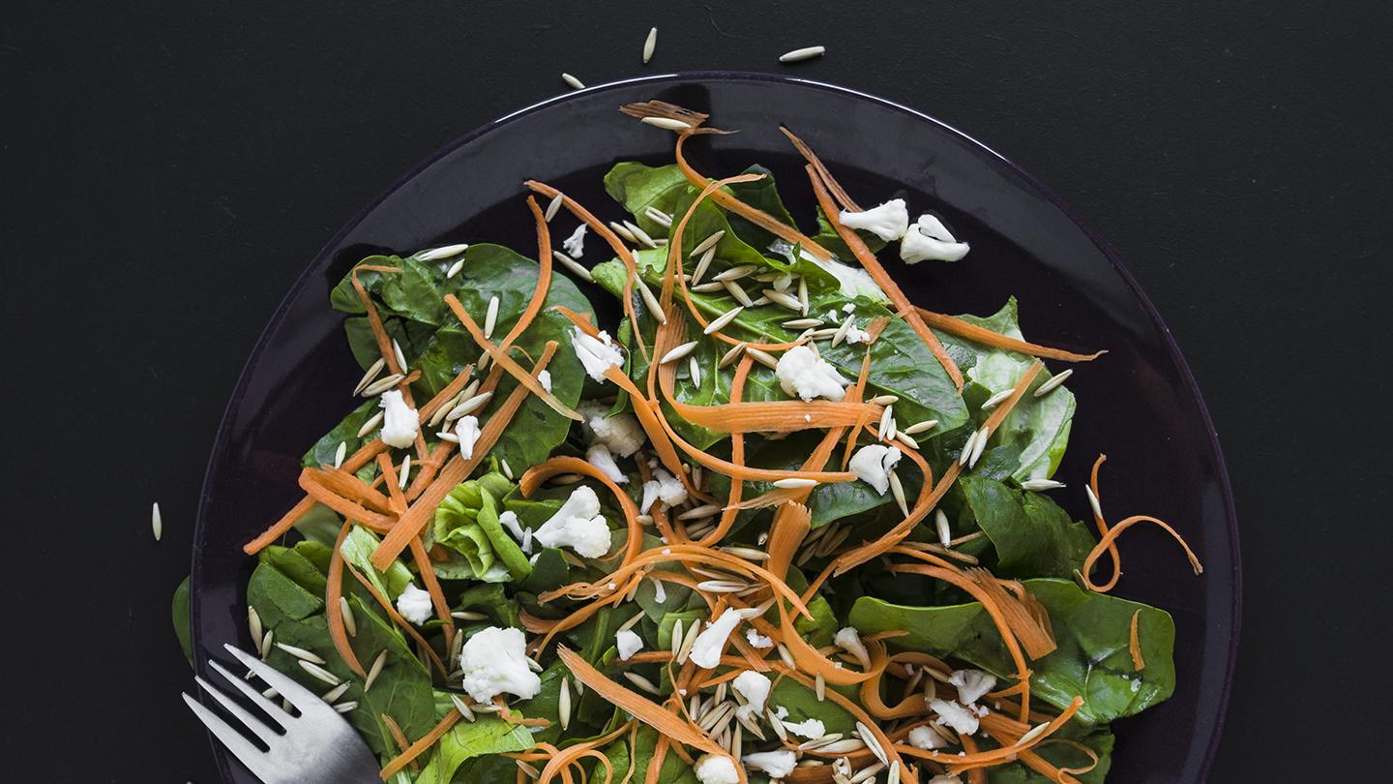
—SOMEONE FAMOUS
“To eat is a necessity, but to eat intelligently is an art. “
Thank you!

